Slide 1

Let’s start with Allah Yaar
Bs in Computer Science

Slide 2
Computer-Controlled Systems
Computer-Controlled Systems
Computer-controlled systems rely on computers to monitor, control, and operate processes or machinery. These systems increase accuracy, efficiency, and automation across various fields.

Slide 3
Computer-Controlled Systems
Key Components
Sensors: Collect data from the physical environment.
Examples: Temperature sensors, light sensors, motion detectors.
Application: A smart home system uses temperature sensors to adjust the air conditioning.

Slide 4
Computer-Controlled Systems
Controllers: Analyze data from sensors and decide actions.
Examples: Microcontrollers, embedded systems.
Application: A washing machine’s controller adjusts water temperature based on load type.
Actuators: Execute the decisions made by controllers.
Examples: Motors, hydraulic pumps.
Application: A robotic arm places items on a conveyor belt.

Slide 5
Computer-Controlled Systems
Types of Computer-Controlled Systems
Embedded Systems: Small computers integrated into devices to perform specific tasks.
Examples: Digital cameras, smart thermostats, or microwaves.
Supervisory Systems: Large-scale systems controlling complex processes like manufacturing.
Example: A steel production plant’s computer system monitors and adjusts furnace operations.

Slide 6
Computer-Controlled Systems
Applications
Healthcare: MRI machines, automatic insulin pumps, and surgical robots.
Example: Da Vinci Surgical System provides surgeons with precision for minimally invasive surgeries.
Transportation: Traffic light control systems optimize traffic flow.
Example: Smart traffic lights adjust signal timings based on vehicle density.

Slide 7
Robotics in Manufacturing
Robotics in Manufacturing
Robotics uses programmable machines to perform repetitive, precise, and hazardous tasks in manufacturing.

Slide 8
Robotics in Manufacturing
Advantages
High Efficiency: Robots work continuously without fatigue.
Enhanced Precision: Reduces human error in tasks requiring accuracy.
Cost Reduction: Long-term savings on labor costs.
Safety: Removes workers from dangerous environments.

Slide 9
Robotics in Manufacturing
Types of Robots in Manufacturing
Assembly Robots: Perform assembling tasks such as fitting parts or welding.
Example: In car manufacturing, robots weld chassis or attach doors.
Material Handling Robots: Move materials, load/unload goods.
Example: Amazon robots move shelves of products in warehouses.

Slide 10
Robotics in Manufacturing
Painting Robots: Apply paint evenly and precisely.
Example: Robots in auto manufacturing spray car bodies for consistent finishes.
Inspection Robots: Check for product defects using cameras and AI.
Example: Robots inspecting circuit boards in electronics manufacturing.

Slide 11
Robotics in Manufacturing
Applications
Automotive Industry: Robots weld, assemble, and paint vehicles.
Example: Tesla’s Gigafactory relies heavily on robots for car production.
Electronics: Robots assemble smartphones and PCs.
Example: Foxconn uses robotics for iPhone manufacturing

Slide 12
Production Line Control
Production Line Control
Production line control involves automating the management of operations in a manufacturing setup to ensure speed, consistency, and quality.

Slide 13
Production Line Control
Key Components
Programmable Logic Controllers (PLCs):
Devices programmed to control machinery based on input conditions.
Example: A bottling plant uses PLCs to fill bottles and cap them automatically.

Slide 14
Production Line Control
Key Components
Supervisory Control and Data Acquisition (SCADA):
Systems for monitoring and controlling industrial processes.
Example: Monitoring oil refinery operations to ensure safety and efficiency.

Slide 15
Production Line Control
Techniques Used
Feedback Loops: Systems adjust based on output (e.g., temperature control in manufacturing).
Real-time Data Analysis: Immediate detection of faults or bottlenecks.
Example: A milk factory uses sensors to monitor filling levels.

Slide 16
Production Line Control
Applications
Textile Industry: Machines weave patterns based on computer instructions.
Example: Automated looms produce intricate fabric designs.
Food and Beverage: Automated systems package and label food items.

Slide 17
Autonomous Vehicles
Autonomous Vehicles
Autonomous vehicles (AVs), or self-driving cars, use advanced technologies to navigate and operate without human intervention.
Core Technologies
Sensors and Cameras: Detect surroundings, including objects, traffic signs, and pedestrians.
Example: Tesla uses ultrasonic sensors and cameras to detect nearby obstacles.

Slide 18
Autonomous Vehicles
Core Technologies
AI Algorithms: Analyze data from sensors to make decisions.
Example: Predicting the movement of pedestrians crossing the road.
GPS and Mapping Systems: Provide accurate navigation and location tracking.
Example: Waymo uses high-resolution maps for route planning.

Slide 19
Autonomous Vehicles
Levels of Autonomy
Level 0: No automation (manual driving).
Level 1: Basic driver assistance (e.g., cruise control).
Level 2: Partial automation (e.g., Tesla’s Autopilot for highway driving).
Level 3: Conditional automation (driver needed for emergencies).
Level 4: High automation (can operate in specific conditions).
Level 5: Full automation (no human intervention).

Slide 20
Autonomous Vehicles
Applications
Passenger Transport:
Self-driving taxis reduce traffic accidents caused by human error.
Example: Waymo operates autonomous taxis in the U.S.
Logistics and Delivery:
Autonomous trucks reduce costs and ensure timely deliveries.
Example: Uber Freight tests autonomous trucks for goods transportation.

Slide 21
Autonomous Vehicles
Applications
Agriculture:
Self-driving tractors and drones automate plowing and spraying.
Example: John Deere’s autonomous tractors use GPS for precision farming.
Military:
Unmanned vehicles for reconnaissance and logistics.
Example: Autonomous drones used for surveillance.

Slide 22
Autonomous Vehicles
Challenges
Safety Concerns: Ensuring reliable performance in complex scenarios.
Legal and Ethical Issues: Who is responsible for accidents involving AVs?
Cost: High development and implementation costs.

Slide 23
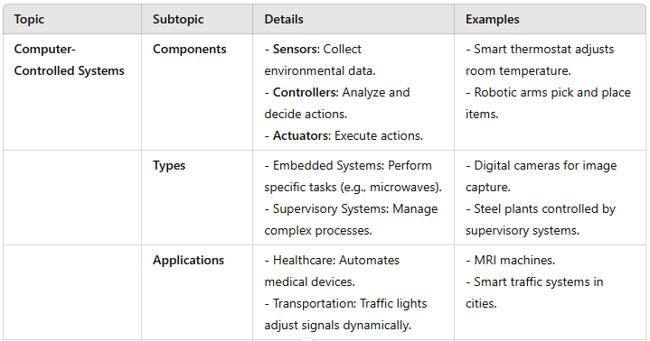
Summary Table

Slide 24
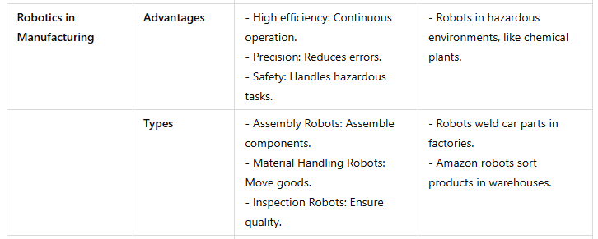
Summary Table

Slide 25
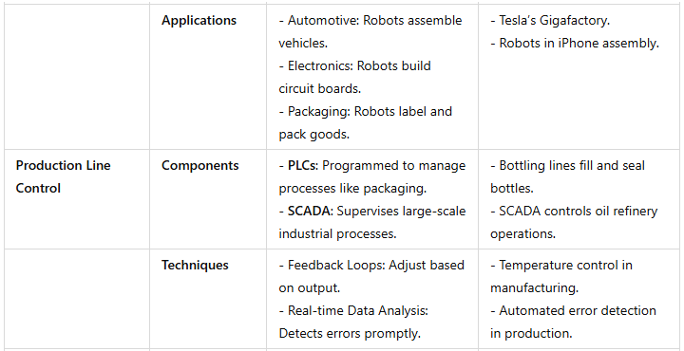
Summary Table

Slide 26
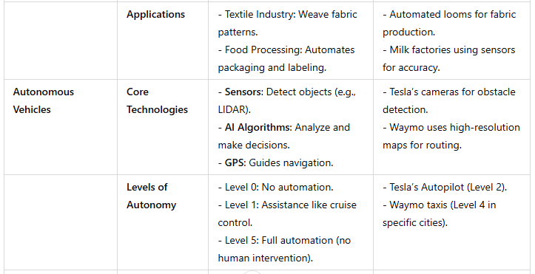
Summary Table

Slide 27
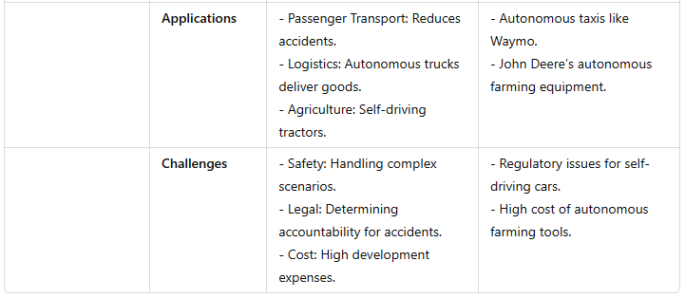
Summary Table

